Slide 1

An introduction to Azure Database for PostgreSQL

Slide 2
Technology changes faster than ever
IoT devices
Cloud computing
Search engines
Cell phones
Internet
Operating systems
Word processor
Microprocessor
Moon landing
Radio
Car
Telephone
Light bulb
Telegraph
Steam engine
Telescope
Printing press
1400
1500
1600
1700
1800
1900
2000
Notes:
The pace of technology advances is accelerating at an unprecedented rate. Breakthrough innovations are causing the volume of data to explode (data from sensors, social media, apps and data found across the enterprise within documents, excel files, for example).
The scale and economics of cloud computing make it possible to capture and harness data, creating new and exceptional opportunities for people and organizations to innovate, grow faster, and achieve more than ever before.
Organizations have the chance to fundamentally redefine the way they engage customers, transform products, optimize operations and engage employees.

Slide 3
Economic stability impacted by disruptive events
COVID-19 pandemic
Black Thursday
Black Monday
Brexit decision
US-China economic conflict
European debt crisis
Greek debt crisis
Great Recession
SARS outbreak
Dot-com bubble
Sept 11 attacks (US)
Early 1990s recession
Savings & loan crisis (US)
Black Monday
Early 1980s recession
Energy crisis
US economic recession
The Great Depression
World War II
World War I
1900s
1920s
1940s
1960s
1980s
2000s
2020s
Notes:
But, as economies become more interdependent, large-scale events can introduce volatility and uncertainty to global markets. Over time, the frequency of these events has accelerated.
How businesses respond in times of uncertainty is as varied as the businesses themselves. Many will slow down operations to operate more cost-effectively, while others may lean into new opportunities that may not have otherwise existed. Across this entire spectrum, the ability to cost-effectively adapt and scale to rapidly changing conditions and manage the underlying risk is paramount.

Slide 4
Be future-ready with Azure
A.I.
Intelligent by default
Scale
Limitless
Hybrid
Operational freedom
Security
Always a step ahead
Notes:
Microsoft Azure is the cloud that lets you turn ideas into solutions with more than 100 services to build, deploy, and manage applications—in the cloud, on-premises, and at the edge—using the tools and frameworks of your choice. Our track record of continuous innovation supports your development today and your visions for tomorrow. Over the past year, we’ve launched over 1000 capabilities on the platform, helping our customers be future-ready. The cloud is moving fast – every week a new technology is coming out. So it’s about meeting new capabilities now and investing in those on the horizon.
In the world of data, we are committed to empowering organizations to build on their terms with flexibility and choice, and that includes the freedom to operate anywhere.
Nothing is more important than trust, particularly when you’re talking about the cloud. We spend $1B a year on cyber security with 3500 cyber security engineers who are constantly monitoring your data for threats. We’ve invested ahead of the curve in layers of security with built-in controls to protect your data and close the gaps that attackers can exploit. Trust your workloads to Azure, built upon the most secure cloud with the broadest compliance coverage.
Break through the resource constraints of modern application development with limitless scale that goes far beyond other cloud providers.
Modernize existing apps or build new apps on Azure with built-in, AI-based technologies that power new customer experiences.
Azure can help you innovate today, tomorrow, and in the future. We are constantly providing capabilities that can help meet your needs.

Slide 5
Azure open-source momentum
>60%
>60%
>47K
>100K
of VM cores are Linux
of Azure marketplace images are Linux-based
customers using Azure open source databases
Azure Data Studio instances with Azure open source database extensions
Notes:
Why should a company consider Microsoft as a top destination for migrating their open source workloads to Azure?
Today over 60% of the virtual machines run on Azure are Linux cores. We have over 47 thousand customers trusting Azure and choosing to run their open source workloads on one of our fully managed open source databases.
Customers are migrating to Azure and modernizing using AKS, Azure App Service, or the many different solutions available as businesses innovate their applications using Azure services.

Slide 6
Open source = PostgreSQL = value
The most loved and wanted database in Stack Overflow’s 2022 Developer Survey
Ranked 2017, 2018 and 2020
DBMS of the Year
by DB-Engines
https://survey.stackoverflow.co/2022/#section-most-loved-dreaded-and-wanted-databases
https://db-engines.com/en/blog_post/85

Slide 7

Why PostgreSQL?
Enterprise ready open source relational database engine
Rich selection of datatypes including text based, numeric, arrays, geospatial, IP, key/value, and JSON
Powerful built-in functions to make working with data easier
Multiple index types to allow for fine tuned performance
Built-in JSON support including indexing of all keys/values within a JSON document for fast retrieval and querying
Rich set of extensions to enable new functionality without relying on new Postgres versions/releases. This includes things like hypothetical indexing, geospatial support, time series partitioning
Notes:
Sources:
https://survey.stackoverflow.co/2022/#section-most-loved-dreaded-and-wanted-databases
https://db-engines.com/en/blog_post/76
https://db-engines.com/en/ranking_trend/system/PostgreSQL

Slide 8
Azure builds upon the core benefits of PostgreSQL
Security
Intelligent performance
Global reach
Modern transactional apps
Compliance
Time series data
Geospatial apps
Extension support
Easy to scale
Azure Database for PostgreSQL is fully-managed, intelligent, and scalable PostgreSQL
Easy ecosystem integration
Built-in HA

Slide 9
The cloud only makes PostgreSQL better
More and more organizations are shifting open source workloads to the cloud to benefit from key advantages:
Enterprise ready open source relational database engine
Lower total cost of ownership
Improved manageability and security
Improved performance and intelligence
Highly scalable

Slide 10

The benefits of Azure Database for PostgreSQL
Build or migrate your workloads with confidence and optimize for value
Highly available and flexible managed database
Migrate to fully managed open source PostgreSQL
Optimize value with a lower total cost of ownership
Simplified developer experience
Advanced data security and compliance
Focus on application innovation with a fully managed, highly available PostgreSQL database, that provides maximum flexibility including zone redundant high availability, custom maintenance windows and AI powered performance optimization
Migrate with ease using a fully managed PostgreSQL databases with support for latest versions. Build with your favorite PostgreSQL extensions and Microsoft’s open-source resources including PostgreSQL extension for Azure Data Studio.
Save up to 62%¹ on a lower total cost of ownership when migrating and modernizing to Azure. Leverage stop/start features, burstable, and reserved instances and only pay for storage when your database is stopped.
Increase productivity with simplified end to end deployment experience. Utilize tight integration with PostgreSQL extensions. Reduce time to market with integration with Azure Kubernetes Service, Azure App Service and more.
Protect your data with enterprise-grade security and compliance, and enhanced security capabilities of Azure Defender and double encryption.
Notes:
¹https://azure.microsoft.com/en-us/resources/analyzing-the-economic-benefit-of-migrating-from-on-premises-instances-to-azure-database-for-postgresql/

Slide 11


Azure relational open-source databases
PaaS and hybrid databases
Azure Database for PostgreSQL
Azure Cosmos DB for PostgreSQL
Platform-as-a-Service
Flexible Server
Distributed Postgres
Best for migrating, modernizing, and building PostgreSQL apps with the broadest Postgres extension support
Best for building cloud-native & digital apps with a fast PostgreSQL database for any scale
Azure Arc-enabled PostgreSQL (preview)
Hybrid
Best for hybrid data workloads operating on any infrastructure with or without a direct connection to the cloud
Notes:
Azure offers both PaaS and hybrid PostgreSQL databases.
Azure Database for PostgreSQL Flexible Server is a fully-managed PostgreSQL database service with zone redundant-HA, maximum control and a simplified developer experience. Flexible server is best for migrating, modernizing, and building PostgreSQL apps with the broadest Postgres extension support.
Azure Cosmos DB for PostgreSQL is a distributed Postgres PaaS offering that is best for building cloud-native & digital apps with a fast PostgreSQL database for any scale
Azure Arc enabled PostgreSQL I is best for your hybrid data workloads that need to operate on any infrastructure with or without a direct connection to the cloud.

Slide 12
Maximum control and flexibility to meet your workload needs with Flexible Server
Maximum control for your databases
Build resilient apps across availability zones
Simplified deployment experience
Control planned downtime with custom maintenance windows
Network isolation with VNet integration and network security groups
Multiple configuration parameters for fine grained database optimization and tuning
Ensure data is always available with zone redundant high availability
Zero data loss within single and multiple availability zones
Minimize latency with co-location of app & data
Full compatibility with community edition MySQL and Postgres
Stop/Start and burstable capabilities for cost optimization
Save up to 62%² on PostgreSQL TCO when migrating to Azure
Notes:
Let’s double click on Flexible Server because it is the top deployment destination for open source databases on Azure.
Flexible Server gives users more control over their databases than running on premises or in VM’s with features such as user-controlled maintenance windows, and configuration parameters for fine grained database tuning & optimization.
Flexible Server is a resilient deployment option with zone redundant high availability to ensure business continuity and zero data loss with multiple availability zones. Additionally, users can minimize application latency by co-locating their application and data in the same Azure region.
To top it off, Flexible Server offers cost-optimization options, such as the burstable service tier, reserved instance pricing to lock in your costs, and stop-start capabilities to ensure users are only paying for storage that they use. Additionally, users can save on a lower total cost of ownership by up to 62% with PostgreSQL when migrating these on premises workloads to Azure.
Overall flexible server is a simplified end-to-end deployment experience offering increased productivity for your open source databases.
² Results are based on interviewed customers. “The Economic Value of Migrating and Modernizing On-premises Instances to Azure Database for PostgreSQL,” a commissioned study conducted by The Enterprise Strategy Group on behalf of Microsoft, July 2022.

Slide 13
Flexible Server use cases*
Transactional and operational analytics
JSON, geospatial support, or full-text search
Cloud-native apps built with modern frameworks
*Use cases also applicable to Single Server

Slide 14





Transactional and operational analytics workloads
Browser
Receive telemetry on state of your devices and message routes from billions of devices
Ingest data into a transactional database that allows you to performantly query timeseries data with richness of SQL
Perform offline rich machine learning or train predictive models
Report and visualize the state of your devices at a granular or aggregated level
Provide insights to users and operators on current device status
Flexible Server
1
2
5
Device
Azure IoT Hub
App Service
3
4
Azure Databricks
Power BI
Notes:
*Flexible Server provides better performance, however the same use cases are applicable for Single Server.

Slide 15


Apps requiring JSON, geospatial, full-text search
Flexible Server
Build your application with both defined schema and unstructured NoSQL type data by leveraging Postgres JSON support
Postgres built-in query planner allows for efficient caching which is great for managing user session state
Advanced geospatial support allows you to layer in location-aware capabilities into your application
Integrated full text search provides rich interactions with data
Use scalable machine learning/deep learning techniques, to derive deeper insights from this data
5
3
Store geospatial e-commerce purchases
Azure Databricks
1
4
Product catalog - JSON
Browser
App Service
Azure Database for PostgreSQL Search
(Full-text index)
2
Session state
App Service
Notes:
*Flexible Server provides better performance, however the same use cases are applicable for Single Server.

Slide 16






Cloud-native applications built with modern frameworks
Browser
1
Deploy and manage containerized applications easily with a continuous integration and delivery experience (CI/CD), and enterprise grade security and governance.
Focus on your app, not the database, with a fully managed database as a service for PostgreSQL. With built-in high availability and rich feature set of Postgres you can build design modern experiences free from legacy constraints.
Offload database demands by managing sessions state and asset caching with Azure Cache for Redis
Alert based on key events such as location or user activity using the serverless compute platform of Azure Functions.
Push timely notifications directly to your users on their preferred service or medium.
Use scalable machine learning/deep learning techniques, to derive deeper insights from this data using Python, R or Scala, with inbuilt notebook experiences in Azure Databricks.
Monitor your application’s performance for degradation or anomalies and auto-scale your application to changing performance requirements.
7
Content Delivery Network
Azure Kubernetes Service
Application Insights
2
3
5
4
Notification Hubs
Azure Functions
Flexible Server
Azure Cache
for Redis
ML Recommendations
6
Azure Databricks
Notes:
*Flexible Server has better performance, however the same use cases are applicable for Single Server.

Slide 17
Using key features – Flexible Server

Slide 18
Optimize costs and lower total cost of ownership
Flexible pricing options
Reserved Capacity
Stop/Start functionality
Burstable compute SKUs
Scale compute, memory, and storage independently and pay only for what you use. Includes automatic database patching, query optimization, and security all at no extra cost.
Choice of 1-year or 3-year Reserved Capacity pricing and save up to 60 percent compared to the regular pay-as-you-go payment options.
Stop the PostgreSQL server when it's not needed for up to 7 days. When the database is stopped, only pay for storage
Utilize Burstable CPU credits for workloads that need extra performance during peak times
No upfront cost. No termination fees. Pay only for what you use.

Slide 19
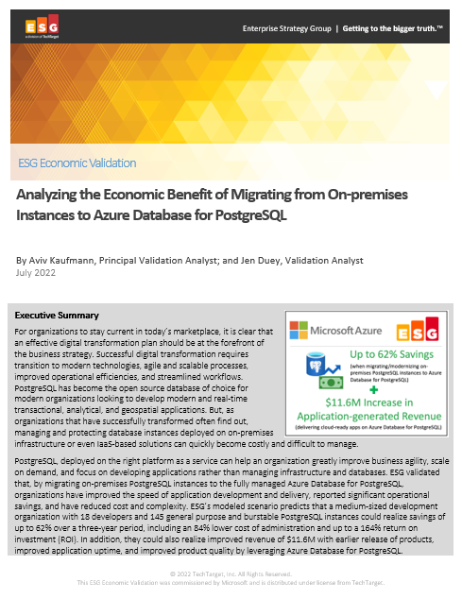
Significantly reduce cost when migrating workloads to PaaS
Key report benefits and findings¹
Up to 62%
Cost savings when migrating on-premises PostgreSQL instances to Azure Database for PostgreSQL
Microsoft commissioned Enterprise Strategy Group to conduct an Economic Value study to examine potential cost savings and business benefits enterprises would achieve from migrating on-premises workloads to Azure Database for PostgreSQL.
Modernizing on Azure Database for PostgreSQL yields even greater benefits…
+$11.6M
Additional revenue due
to faster time to market
84%
Reduction in
operational cost
164%
based on the expected savings and benefits
71%
Lower cost of systems administration
1 Results are based on interviewed customers. “Analyzing the Economic Benefit of Migrating from On-premises Instances to Azure Database for PostgreSQL,” a commissioned study conducted by The Enterprise Strategy Group on behalf of Microsoft, July 2022.
Notes:
We partnered with the Enterprise Strategy Group to validate the cost savings, operational efficiency, and improved business agility that customers reported when migrating their on-premises PostgreSQL instances to Azure Database for PostgreSQL Flexible Server and the TOP-LEVEL FINDINGS from ESG’s model FOUND THAT Azure Database for PostgreSQL provided UP TO a 62% LOWER TOTAL COST over a three-year period to deliver the services to host, secure, and protect PostgreSQL instances.
This included an enormous 84% reduction in the operational cost to deploy, manage, and maintain PostgreSQL instances on an on-premises environment. Azure Database for PostgreSQL offloads the majority of the work currently performed by developers, which reduces the EXPECTED cost to administer, tune, secure, protect, and maintain the MySQL databases by UP TO 71%.
These savings equate to roughly 4 full-time developers’ worth of PRODUCTIVITY SAVED, which equates to a 21% increase in development capacity, resulting in $11.6M dollars in additional expected revenue for the organization.
This is a perfect example of how Azure managed open source databases can reduce your total cost of ownership when migrating your workloads to Azure.

Slide 20
Simplified Developer Experience
Boost productivity
Smart
integrations
Easy and cost effective to get started
Guided developer experience increases productivity and simplifies end-to-end deployment
Full compatibility with community edition PostgreSQL. Reduce time to market with tight integration to Azure Kubernetes Service, Azure App Service and more
Option to get started for free with Azure free accounts. Leverage burstable or reserved instance pricing and start/stop capabilities to optimize cost

Slide 21
Zone-redundant High Availability
Zone-redundant HA pic
A synchronous standby replica automatically deployed in a different availability zone (AZ) than the primary DB deployed AZ.
Zero data loss in the event of a planned or unplanned failover
Physically separate synchronous copy of data maintained using Postgres streaming replication
Automatic failure detection and failovers using internal monitoring mechanisms
High uptime during planned and unplanned outages
Region-1
Primary
(AZ-1)
Standby
(AZ-2)
Note: Zone Redundant High Availability with up to 99.99% SLA.

Slide 22
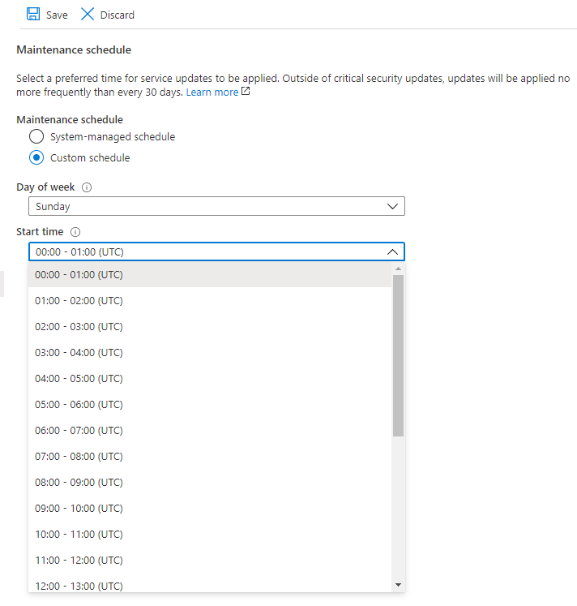
Custom Maintenance Windows
Control planned downtime with custom maintenance windows
Server with high availability enabled is updated via failover to updated standby node
Multiple configuration parameters for fine grained database optimization and tuning

Slide 23


PgBouncer Integration
Managed server-side connection pooler
No need to restart
Connection to the database server via port 6432 routes via PgBouncer
Connect to 5432 outside of PgBouncer
Optional feature
PostgreSQL Clients
Linux VM
Host: mypgserver.postres.database.azure.com
Azure VM
PgBouncer
AKS
Port 6432
Port 5432
App Service
* Feature available for General Purpose & Memory optimized SKUs

Slide 24
Work smarter with intelligent performance optimization features
Intelligent performance
Performance troubleshooting
Data visualization
Customized recommendations
High performance workloads
Improve performance and decrease cost with comprehensive database monitoring and optimization tools
Automatically track and log query performance over time
Visualize query performance data to identify how your longest running queries change over time
Azure analyzes the workloads across your server to generate customized performance recommendations
Support for zone co-location required by low-latency workloads

Slide 25









Monitor Azure Database for PostgreSQL with Azure Monitor
Insights
Application
Container
VM
Monitoring Solutions
Azure Database for PostgreSQL tracks performance metrics and logs telemetry data
Collect, analyze, and take action on telemetry data gathered from your database using Azure Monitor
Better understand your apps with deep insights into app and database behavior, view alerts, and build remediation plans
Visualize
Azure Monitor
Dashboards
Views
Power BI
Workbooks
Metrics
Analyze
Metric Analytics
Log Analytics
Logs
Respond
Alerts
Autoscale
Integrate
Logic Apps
Export APIs
Notes:
https://docs.microsoft.com/en-us/azure/postgresql/concepts-monitoring

Slide 26

Protect data with multiple layers of security
Azure provides multiple layers of security to safeguard your data
Native authentication
Threat detection
Monitor access
Secure SSL connectivity
Server firewall rules
Virtual Network (SE)
Control access
Built-in encryption for data at rest and in motion
Protect data

Slide 27



Protect against malicious action with Azure Defender
Supported on Single Server
Coming to Flexible Server in 2022
Azure Defender uses Active Directory signals to identify and investigate user-based threats
After creating a behavioral baseline for each user, Azure ATP identifies suspicious activity with built-in adaptive intelligence
Reduce vulnerabilities with configuration insights and suggested best-practices
Decrease alert noise with visibility to simple lateral movement paths and real-time attack timelines
Azure portal
Just turn it on
Azure Defender*
Actionable alerts
Developer
Azure Security Center (ASC)
Notes:
ATP all up
https://docs.microsoft.com/en-us/azure-advanced-threat-protection/
ATP Sizing
https://docs.microsoft.com/en-us/azure-advanced-threat-protection/atp-capacity-planning

Slide 28






Take advantage of a leading compliance portfolio
Supported on Single Server
Coming to Flexible Server in 2022
Protect your data with up-to-date compliance features, including the following standards:
SOC 2
Type 2
HITRUST
HIPAA
PCI DSS
GxP
FedRAMP
SOC
ISO 9001:2015
ISO 27018:2014
ISO 27017:2015
ISO 27001:2013
ISO 20000-1:2011
CSA STAR certification
Level 1
CSA STAR
Certification

Slide 29
Replicate data for greater scale
Supported on Single Server
Coming to Flexible Server in 2022
Read replicas help improve performance and scale of read-intensive workloads such as BI and analytics
Consider the read replica features in scenarios when delays in synching data between the master and replicas are acceptable
Create a replica in a different Azure region from the master for a disaster recovery plan, where a replica replaces the master in cases of regional disasters
Data storage on replica servers grows automatically without impacting workloads
Create up to five replicas of the master server
Master server
Asynchronous updates
Read Replica #1
Read Replica #2
Read Replica #3
Read Replica #4
Read Replica #5
Notes:
https://docs.microsoft.com/en-us/azure/postgresql/concepts-read-replicas

Slide 30
Capture query data with Query Store
Supported on Single Server
In preview for Flexible Server
Query Store simplifies performance troubleshooting by helping you quickly find the longest running and most resource-intensive queries
Capture a history of queries and runtime statistics by time windows to reveal usage patterns
Opt-in to enable Query Store globally across all of your PostgreSQL databases
Length of individual queries with Query Store
Query times
Time
Notes:
Query Store simplifies performance troubleshooting by helping you quickly find the longest running and most resource-intensive queries
https://docs.microsoft.com/en-us/azure/postgresql/concepts-query-store

Slide 31
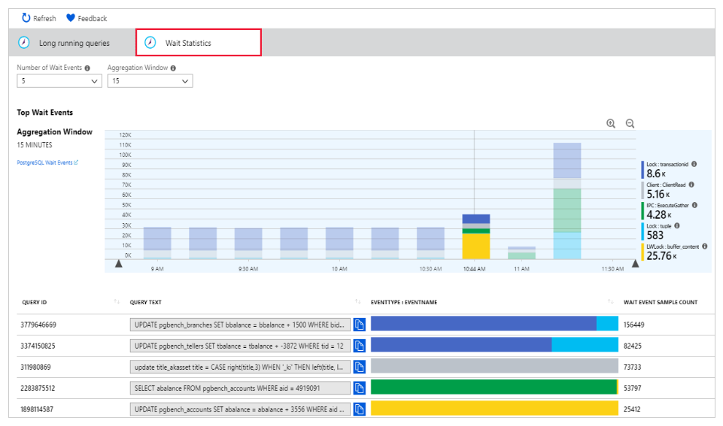
Review performance details with Query Performance Insight
Supported on Single Server
In preview for Flexible Server
Wait statistics in Query Performance Insight
Quickly identify your longest running queries, how they change over time and what waits are affecting them
The Query Performance Insight view in the Azure portal surfaces visualizations on key information from Query Store
The long running queries tab shows the top five queries by average duration per execution, aggregated in 15-minute intervals
Users can view additional queries and alter the time window
Notes:
Query Performance Insight helps you to quickly identify what your longest running queries are, how they change over time, and what waits are affecting them
https://docs.microsoft.com/en-us/azure/postgresql/concepts-query-performance-insight

Slide 32
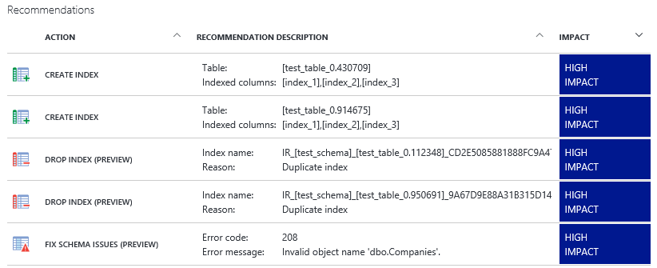
Customize suggestions with Performance Recommendations
Supported on Single Server
In preview for Flexible Server
Azure portal performance recommendations
Performance Recommendations analyzes your PostgreSQL database to create customized suggestions for better performance
Two types of recommendations are supported:
Create Index recommendations suggest new indexes to accelerate the most frequently run or time-consuming queries
Drop Index analyzes existing indexes and recommends dropping indexes that are rarely used or redundant
Notes:
The Performance Recommendations feature analyses your databases to create customized suggestions for improved performance
https://docs.microsoft.com/en-us/azure/postgresql/concepts-performance-recommendations

Slide 33
Support for the latest PostgreSQL versions
Version 14 Coming to Flexible Server in 2022
Azure aims to support the current major version and the two prior major versions of PostgreSQL
Azure Database for PostgreSQL automatically manages minor version patches
Major version upgrade is not supported; to upgrade, create a database dump and restore it to a server created with the new engine version
Postgres version 10 is available on Single Server only.
Release versions supported by Azure Database for PostgreSQL
11
12
13
14*
Notes:
https://docs.microsoft.com/en-us/azure/postgresql/concepts-supported-versions

Slide 34
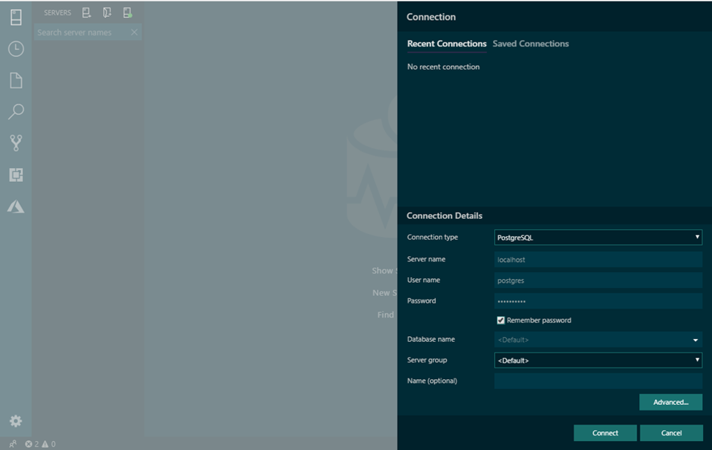
Get started with open source extensions
Supported on Single Server
Coming to Flexible Server in 2022
Microsoft is committed to contributing to, working with and supporting access to the Postgres community and its innovations
Microsoft contributions to the Postgres community:
Azure Data Studio PostgreSQL extension enables you to connect to, query, and develop PostgreSQL using a modern data editor
Visual Studio Code extension streamlines code editing with built-in git commands and optimization for quick code-build-debug cycles
And more, including pg_auto_failover, cstore_fdw, hll, pg_cron, topN, and Citus Community
Azure Database for PostgreSQL also supports popular PostgreSQL extensions including PostGIS, Timescale*, pg_prewarm, pg_stat_statements, and many more
Connecting to PostgreSQL on Azure Data Studio
Notes:
Azure Data Studio: An Open Source GUI Editor for Postgres: https://azure.microsoft.com/en-us/blog/azure-data-studio-an-open-source-gui-editor-for-postgres/
PostgreSQL extension (preview): https://docs.microsoft.com/en-us/sql/azure-data-studio/postgres-extension?view=sql-server-2017
PostgreSQL extensions in Azure Database for PostgreSQL – Single Server: https://docs.microsoft.com/en-us/azure/postgresql/concepts-extensions

Slide 35
Flexible Server: Single Server Parity
Features | Single Server | Flexible Server
Database Version | PG 9.6 (deprecated), PG 10 and PG 11 | PG 11, PG 12 and PG 13
High Availability | Built-in HA (99.99%) | Zone Redundant HA (99.99%) No-HA enabled (99.9%)
Scheduled Maintenance | System scheduled | System or custom scheduled
Backup & Restore | P | GeoBackup/Restore (Public Preview)
Network Isolation | P Private Link | P VNET Integration
Customer managed keys for Encryption | P | ~ Coming June 2022
AAD Authentication | P | ~ Coming June 2022
In-region Replicas | P | ~ Coming June 2022
Cross-region Replicas | P | ~ Coming June 2022
Query Performance Insight | P | ~ Coming June 2022
Extensions | TimescaleDB, PLV8. Orafce | ~ Coming March 2022
Auto storage grow | P | ~ Coming March 2022
Azure Defender | P | ~ Coming in 2022

Slide 36
Flexible Server: Additional GA Capabilities
Features | Single Server | Flexible Server
Burstable SKU | No | P
Easy movement across all SKUs | No | P
Stop/Start | No | P
Integrated PgBouncer | No | P
Richer set of Server Parameters |  | Example: Shared_buffers, Max_connections
AZ Resilient HA | No | P
Extensions |  | Pglogical, Pg_cron, Bloom, Pginspect
Free Tier offer | No | 12 months free
Auditing | Public Preview | GA
Use Flexible Server for:
Simplified Developer Experience
Better Cost Optimization options
Predictable Lower Latency
Competitive out-of-box performance
Customized Maintenance
Richer Server parameters
Zone-Redundant High Availability

Slide 37
Migration resources

Slide 38





PostgreSQL migration to PaaS
Empower customers to be free from database management by migrating on-premises and IaaS PostgreSQL workloads to Azure Database for PostgreSQL
Enable PostgreSQL workloads to take advantage of Azure’s enterprise-ready features on security, compliance, and intelligent performance
Choose the migration approach that best fits the needs of your customer’s workloads
Reduce downtime on critical databases with Azure Database Migration Service
Ideal for migrating on-premises or IaaS PostgreSQL to Azure
Options for migrating to Azure Database for PostgreSQL
Discover and assess
DMS Continuous Sync
Azure Database Migration Service
Test
Connect to Azure with your favorite tool
Import/Export
Remediate apps
Dump and store
Optimize
Migrate schema and data

Slide 39
Two options to migrate to Azure Database for PostgreSQL
Recommended approach
Option 1
Azure Database Migration Service
Minimize downtime with continuous sync
Recommended for full database migrations and in-production applications
Option 2
Proof of concept migration
Pg_dump + pg_restore
Pg_dump + psql
Use dump and restore or import/export for faster migrations
Recommended for testing and proof of concept scenarios only

Slide 40
Migrating to Azure Database for PostgreSQL
Opportunity
DBAs spending time maintaining their databases, not focused on their apps
Azure Database for PostgreSQL
Solution
Azure Database for PostgreSQL takes care of patching, high availability, and performance management
Provides added benefits of comprehensive, intelligent security and compliance, including threat alerts
Azure Database Migration Services
On premises PostgreSQL
VM PostgreSQL
Other Managed Services

Slide 41

Migration from Oracle to Azure Database for PostgreSQL
Opportunity
Oracle license cost is expensive and additional features (such as partitioning and high availability) come at added cost
Azure Database for PostgreSQL
Azure Database Migration Services
Solution
Migrating to Azure Database for PostgreSQL removes need for licenses as the customer can take advantage of open source PostgreSQL
Single instance of Oracle

Slide 42
Migration from Single to Flexible
PG single to flexible server automation tool
Public Preview in Jan 22
Comes with a CLI and portal Experience
Documentation
Opportunity
Existing single server customers are facing issues in terms of availability, connectivity, performance and query execution, thereby causing an intense live site load.
Azure Database for PostgreSQL Flexible Server
PG Single to Flexible server automation tool
Solution
Flexible server is a high performant deployment option built to address the above issues faced by customers. Migrating existing single server customers to flexible server would reduce live site load and improve customer satisfaction.
Azure Database for PostgreSQL Single Server

Slide 43
Azure migration resources
Migration guidance
Azure Database Migration Guide
Azure Database Migration Service
DMS homepage
Azure Database for PostgreSQL documentation
How to migrate using dump and store
How to migrate using export and import
How to migrate online

Slide 44
Resources to learn more
Azure service page: http://aka.ms/postgresql
Documentation: Azure Database for PostgreSQL
Discussion forum: MSDN, StackOverflow
Feedback forum: User Voice
Hands-on Lab: http://aka.ms/postgresqlhol
GitHub repo: https://github.com/Azure/azure-postgresql

